Slide 1
Intro to RegEx
Ailsa Prise
04 Feb 2021

Slide 2
What are Regular Expressions?
Commonly referred to as regex/regexp
A way to describe patterns in strings of text
Used across many programming languages
Useful in so many situations!
Find certain patterns in data
Guard against incorrect data entry
Help to find connections in data beyond literal exact matches
Filter data to relevant cases
Data validation - avoid collecting incorrectly formatted data (e.g. is that a phone number?)
Data cleaning e.g. identifying a phone number in an email address field
Complex search & replace
Provide helpful error messages if you receive incorrect input

Slide 3
Problems
Code for web colours:
#(?:[a-f\d]{3}){1,2}\b|rgb\((?:(?:\s*0*(?:25[0-5]|2[0-4]\d|1?\d?\d)\s*,){2}\s*0*(?:25[0-5]|2[0-4]\d|1?\d?\d)|\s*0*(?:100(?:\.0+)?|\d?\d(?:\.\d+)?)%(?:\s*,\s*0*(?:100(?:\.0+)?|\d?\d(?:\.\d+)?)%){2})\s*\)|hsl\(\s*0*(?:360|3[0-5]\d|[12]?\d?\d)\s*(?:,\s*0*(?:100(?:\.0+)?|\d?\d(?:\.\d+)?)%\s*){2}\)|(?:rgba\((?:(?:\s*0*(?:25[0-5]|2[0-4]\d|1?\d?\d)\s*,){3}|(?:\s*0*(?:100(?:\.0+)?|\d?\d(?:\.\d+)?)%\s*,){3})|hsla\(\s*0*(?:360|3[0-5]\d|[12]?\d?\d)\s*(?:,\s*0*(?:100(?:\.0+)?|\d?\d(?:\.\d+)?)%\s*){2},)\s*0*(?:1|0(?:\.\d+)?)\s*\)
RegEx can be very powerful…
But also hugely complex
Code for UK postcodes: \b(GIR ?0AA|SAN ?TA1|(?:[A-PR-UWYZ](?:\d{0,2}|[A-HK-Y]\d|[A-HK-Y]\d\d|\d[A-HJKSTUW]|[A-HK-Y]\d[ABEHMNPRV-Y])) ?\d[ABD-HJLNP-UW-Z]{2})\b

Slide 4
There are lots of irregularities in language and human design
Interesting reading
Falsehoods programmers believe about names
Falsehoods programmers believe about addresses
Falsehoods programmers believe about time
More!

Slide 5
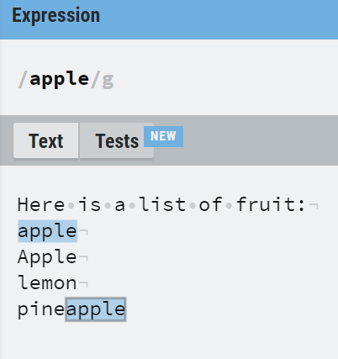

The basics
Matching exact strings
“apple” will match anything with that string included.
apple
pineapple
lemon
Apple

Slide 6
The basics
Helpful shorthand for character matching
Magic character | Meaning | Example matches
. | Matches any character | “.a” matches “pineapple”, not “apple”
\d | Matches any digit | “\d” matches “4”, not “four”
\s | Matches any whitespace | “\s” matches “pine apple”, not “pineapple”
[abc] | Matches a, b or c | “[abc]” matches “apple”, not “lemon”
[^abc] | Matches anything except a, b or c | “[^abc]” matches “lemon”, not “apple”
[a-e] | Character in range a-e | “[a-e]” matches “apple” AND “lemon”
[a-z] | Any lowercase character | “[a-z]” matches “four”, not “4”
[a-zA-Z] | Any lower or uppercase character | “[a-zA-Z]” matches “apple” AND “Apple”

Slide 7
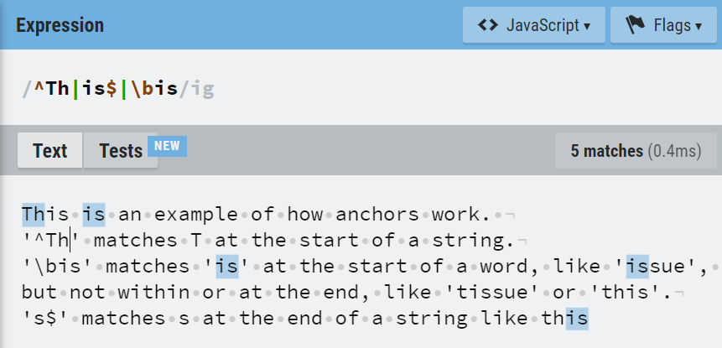
The basics
Anchors
Magic character | Meaning | Example matches
^ | Start of string | “^a” matches “apple”, not “pineapple”
$ | End of string | “a$” matches “banana”, not “apple”
\b | Word boundary | “\bapple” matches “apple”, not “pineapple”

Slide 8
The basics
Magic character | Meaning
? | 0 or 1
+ | 1 or more
* | 0 or more
{n} | Exactly n times
{n,} | n or more
{,m} | At most m
{n,m} | Between n and m times
Repetition

Slide 9
Some extra points
Matches never overlap.
For e.g., “banana” contains one instance of “ana”, not two.
You can use | to pick between one or more patterns.
For e.g., “abc|def” will match either ‘“abc” or "def".
You can use parentheses, as you would in mathematical expressions.
For e.g., “T(i|o)m” will match either “Tim” or “Tom”

Slide 10
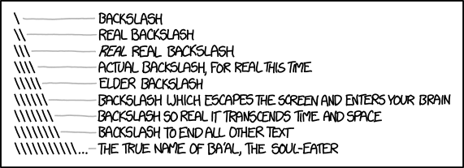
R and regex
Escaping special characters
Sometimes you will want to match a character that has a special meaning in regex. To do that, use a backslash.
A “.” matches any character, so how do you match an actual “.”? – escape with a \ - “\.”
However, backslashes are also used as escape symbols in strings in R, so you need to escape the escape symbol AND the special characters.
So in R Regex, this needs to be “\\.”
This can get particularly intense when you are trying to match a literal backslash.
“\\\\”

Slide 11
R and regex
Some useful functions
stringr::str_view()
Show you how a character vector and regular expression match. Will only match the first instance of a pattern, use string_view_all to match all.
stringr::str_which / grep()
Returns the index position of matches.
stringr::str_detect / grepl()
Returns a logical vector. These also therefore allow you to count the number of matches when combined with sum(), for example.
stringr::str_extract()
Extract only the parts of a character vector that match a regex. Also only matches the first instance, use str_extract_all to match all.
stringr::str_replace() / gsub()
Replace matches with another defined string.

Slide 12
Regexercises
Write a regex that will match…
Challenge 1: Words that start with a consonant and end with a vowel
Challenge 2: Words in ALL CAPS
Challenge 3: British mobile phone numbers
Challenge 4: Usernames at least 8 characters long, using only letters and numbers

Slide 13
Further resources
General cheatsheet - https://www.rexegg.com/regex-quickstart.html
R-specific cheatsheet (printable) - https://github.com/rstudio/cheatsheets/raw/master/regex.pdf
R4ds chapter on strings - https://r4ds.had.co.nz/strings.html
Recent blog on regex - https://blog.rsquaredacademy.com/regular-expression-in-r/
Regex crosswords to practise on - https://regexcrossword.com/
Website to quickly test out patterns - https://regexr.com/

